Slide 1
Immunising Networks
Yiyoung Kim

Slide 2
THE QUESTION
A certain viruses spread on a network. If there is the limited number of vaccines, how to prioritize people until the network becomes disconnected.
Starting from a given network with community structure, prioritize nodes to be immunised to fragment the network into small pieces with a small number of immunisations administered. Test proposed methods and compare their performance with other methods.

Slide 3
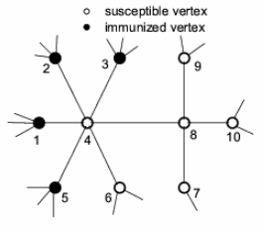
Networks
Nodes
Edges – a connection between nodes
Degree – the number of edges connected to a node
Directed – if an edge runs in one direction
Undirected – if an edge runs in both directions
Networks with community structure
=a group structure

Slide 4
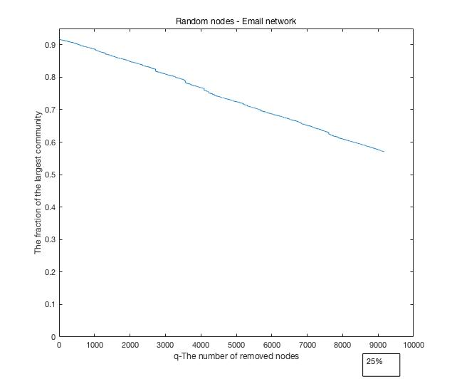
Method 1 – Remove random nodes
Description of the tested network
Email network
Data set of email communication
If address i sent an email to j, two nodes are connected.
The number of nodes = 36692
The number of edges = 183831
Undirected graph
Even though 25% of nodes are removed randomly, the fraction of the largest group is about 60% of the network
http://snap.stanford.edu/data/email-Enron.html

Slide 5
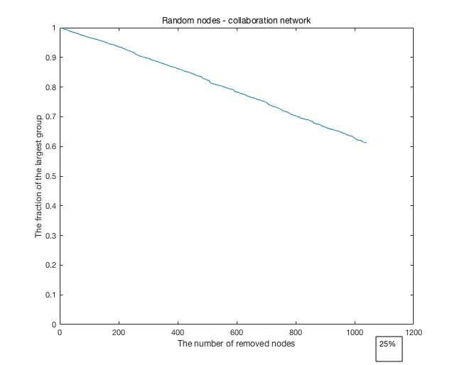
Method 1 – Remove random nodes
Description of tested network
Scientific collaborations network
Data set of email communication
If an author i co-authored a paper with author j, two nodes are connected.
The number of nodes = 4158
The number of edges = 13422
Undirected graph
Even though 25% of nodes are removed randomly, the fraction of the largest group is about 60% of the network
http://snap.stanford.edu/data/ca-GrQc.html

Slide 6
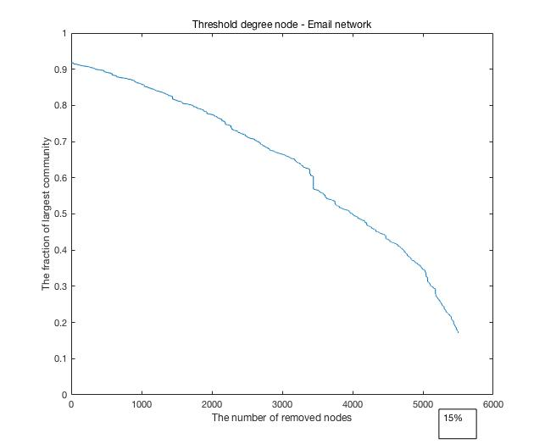
Method 2- Threshold degree
Email network
Choose one node from the network, and remove it, if the degree of the node is above a threshold.
Threshold degree= 7
When 15% of nodes are removed, the fraction of the largest group is about 20% of the network.

Slide 7
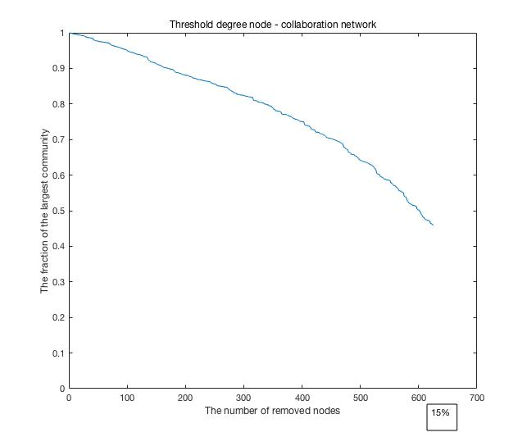
Method 2- Threshold degree
Collaboration network
Choose one node from network, and remove it, if the degree of the node is above a threshold.
Threshold degree= 7
When 15% of nodes are removed, the fraction of the largest group is about 45% of the network.

Slide 8
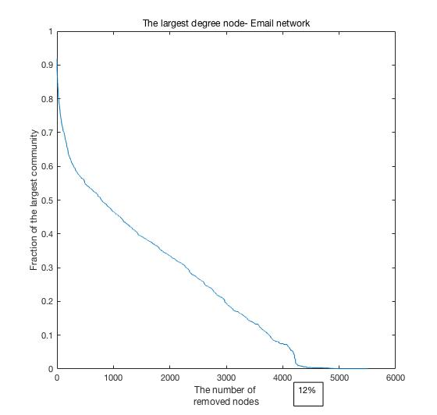
Method 3- The largest degree node
Email network
Remove a node which has the largest degree in the network.
When 12% of nodes are removed, the fraction of the largest community is about 0.

Slide 9
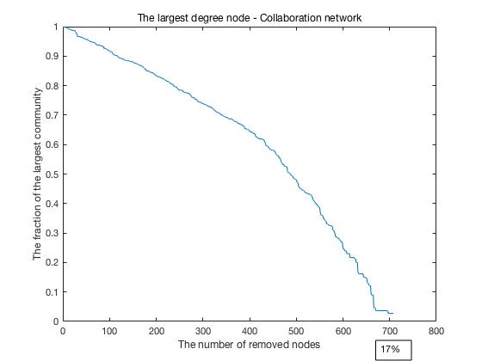
Method 3- The largest degree node
Collaboration network
Remove a node which has the largest degree in the network.
When 17% of nodes are removed, the fraction of the largest community is about 0.

Slide 10
Compare between methods - Email
Method 1
Method 2
Method 3
25%
15%
12%

Slide 11
Compare between methods -Collaboration
15%
17%
25%

Slide 12
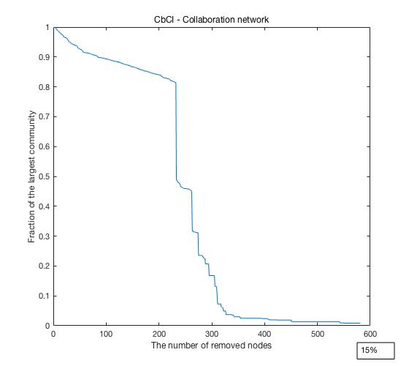
Further studies…

Slide 13
Further studies…
Other methods
eg) Edge attack methods etc
Other network models
eg) Barabasi and Albert model etc
Difficulties – Some networks are too big to simulate on MATLAB. Efficient algorithm is needed.

Slide 14
Questions

